Slide 1
A color coding method

Slide 2
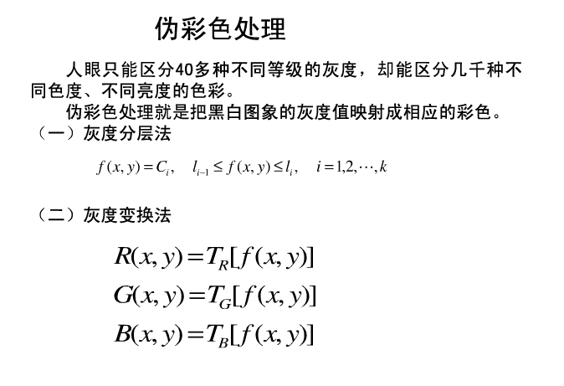

Slide 3
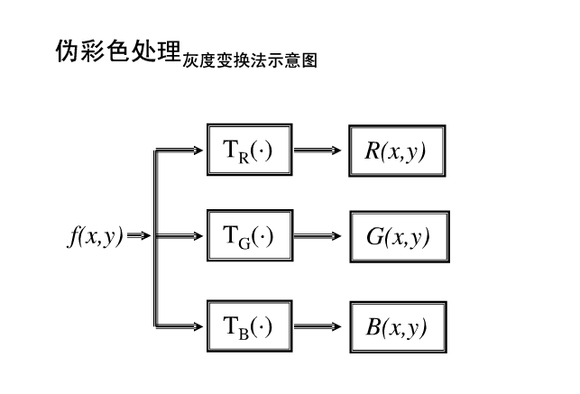

Slide 4
for i = 1:m
for j = 1:n
if Image(i,j) < Len/16
R(i,j) = 0;
G(i,j) = 0;
B(i,j) = 0;
elseif Image (i,j) < Len/8
R(i,j) = 26;
G(i,j) = 16;
B(i,j) = 63;
elseif Image (i,j) < 3*Len/16
R(i,j) = 45;
G(i,j) = 24;
B(i,j) = 84;
… … … …
else
R(i,j) = 255;
G(i,j) = 255;
B(i,j) = 255;
Re_image= repmat(I,[1 1 3]);
for i = 1:m
for j = 1:n
Re_image(i,j,1) = R(i,j);
Re_image(i,j,2) = G(i,j);
Re_image(i,j,3) = B(i,j);
end
end
fR=new(:,:,1);
fG=new(:,:,2);
fB=new(:,:,3);
w=fspecial('average');
fR_filtered=imfilter(fR,w,'replicate');
fG_filtered=imfilter(fG,w,'replicate');
fB_filtered=imfilter(fB,w,'replicate');
fc_filtered=cat(3,fR_filtered,fG_filtered,fB_filtered);
fR_medfilt2=medfilt2(fR,[10 10]);
fG_medfilt2=medfilt2(fG,[10 10]);
fB_medfilt2=medfilt2(fB,[10 10]);
fc_medfilt2=cat(3,fR_medfilt2,fG_medfilt2,fB_medfilt2);

Slide 5
Black→ dark blue → magenta → orange → yellow → white

Slide 6
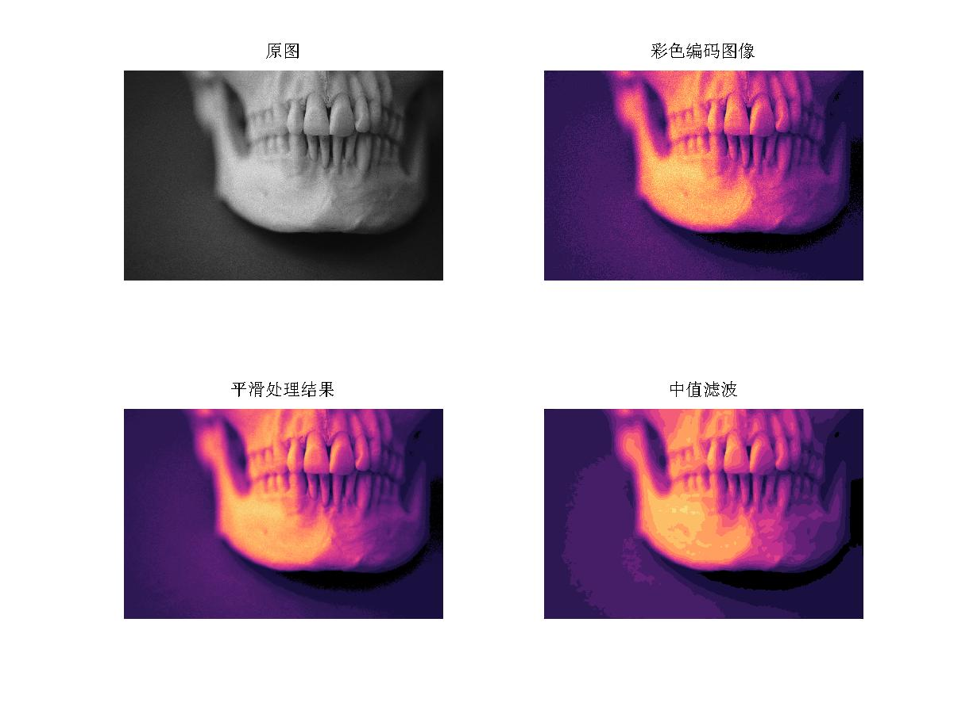

Slide 7
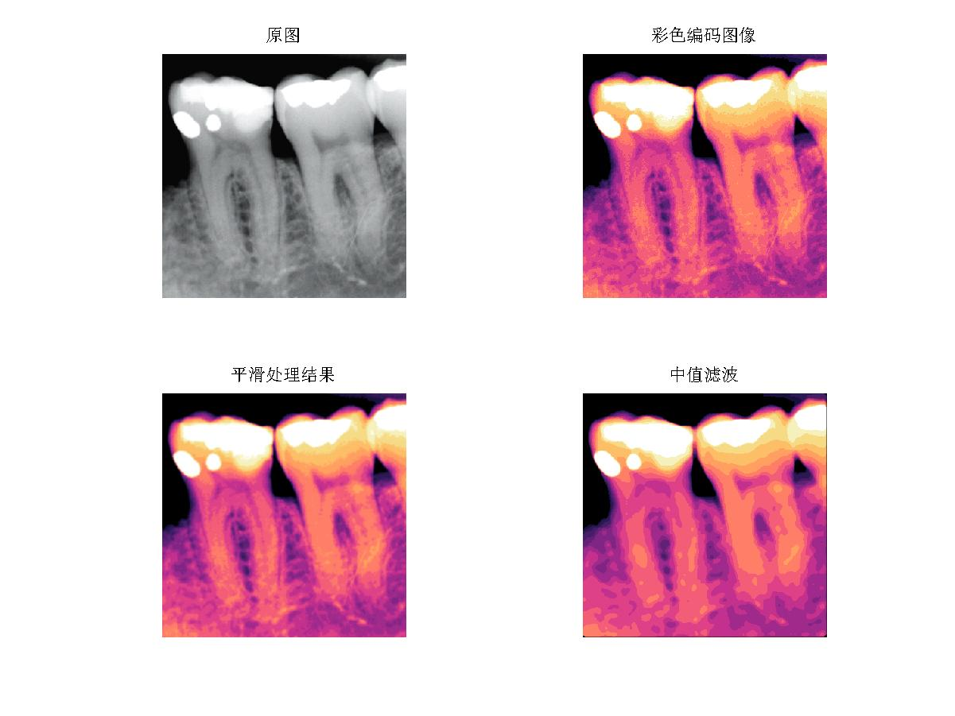

Slide 8
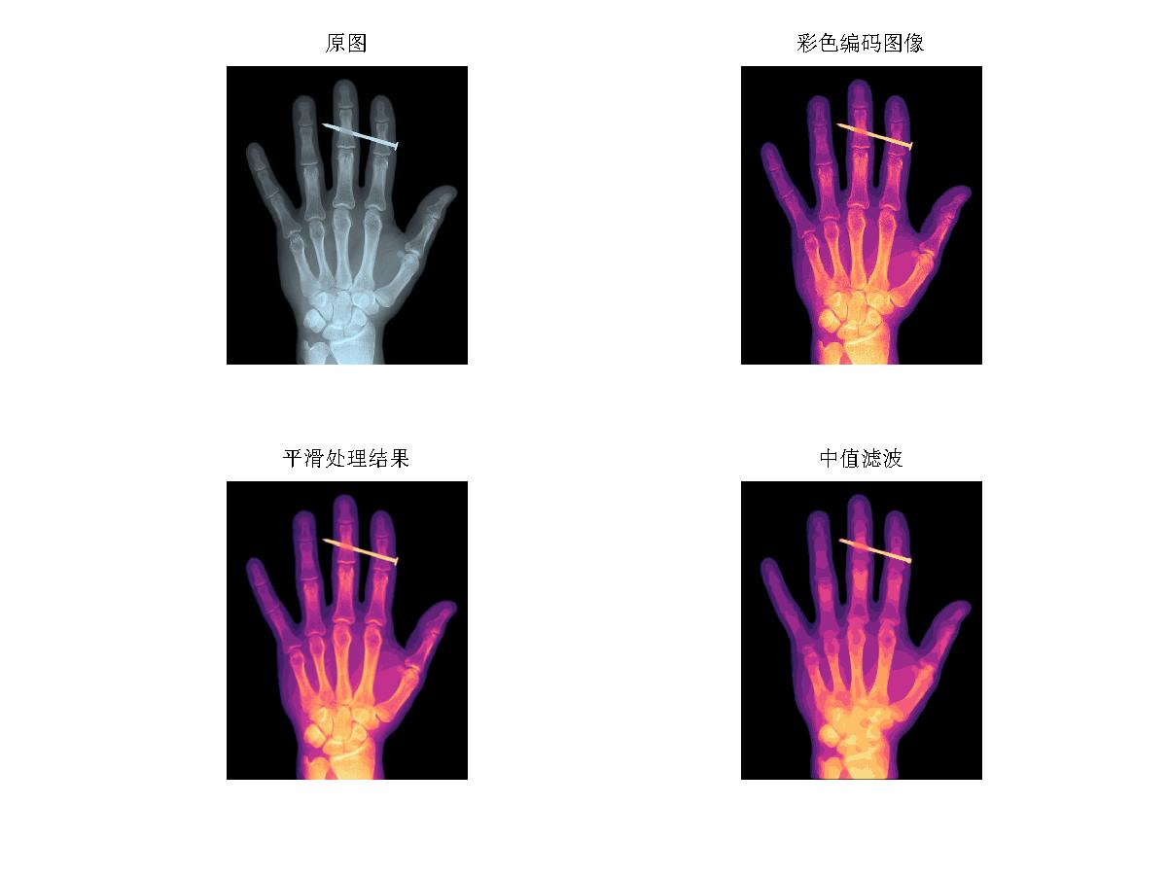

Slide 9
g = grayslice(f,16);
原灰度图分成16个层次
I = imread(‘@_@.jpg');
X = grayslice(I,16);
imshow(I)
figure, imshow(X,jet(16))

Slide 10
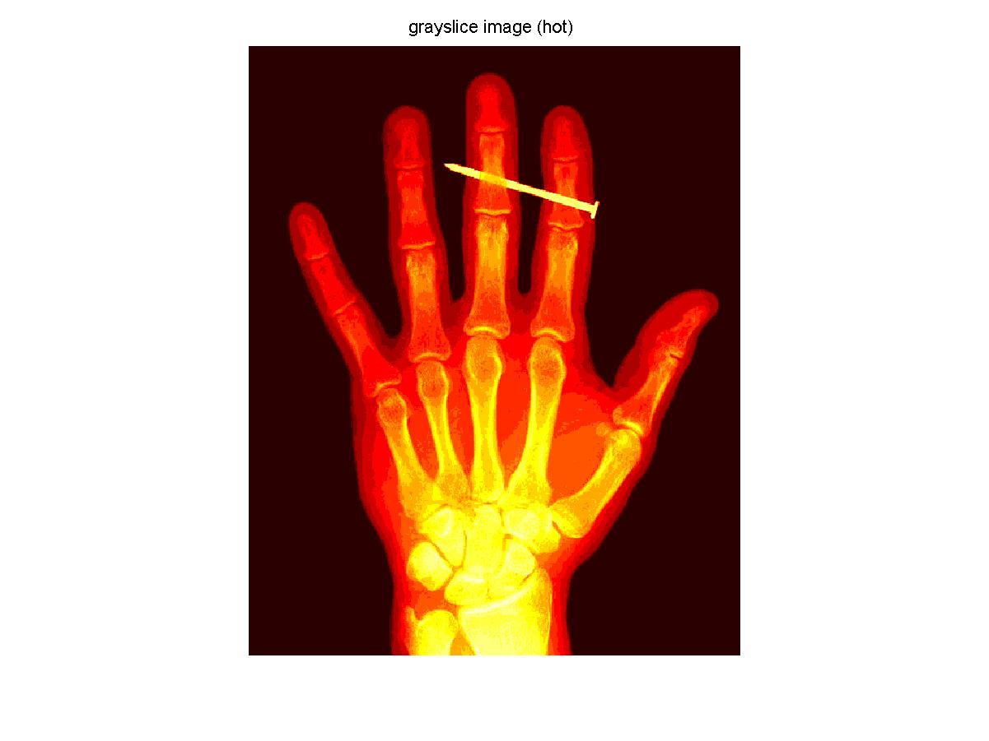
Hot
Black
↓
Red
↓
Yellow
↓
white

Slide 11
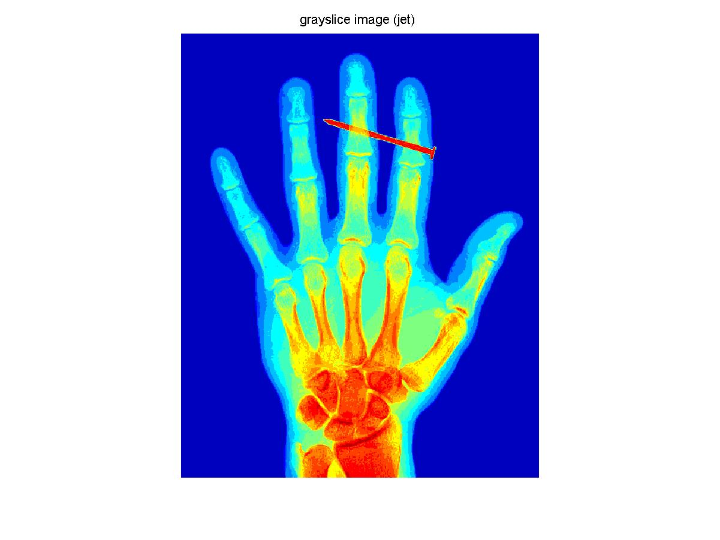
Jet
dark blue
↓
blue
↓
Cyan
↓
Green
↓
Yellow
↓
Red
↓
dark red

